Slide 1



Bird Species Classification Using Vision Transformers
Mentor : Prof. Kirti Mishra
Members
Sakshi Borade - 1610121026
Atharv Chandane - 16010121030
Kunal Chaturvedi - 16010121032
Sahil Chauhan - 16010121034
Vedant Chavan - 16010121035

Slide 2
Problem Definition
In the realm of ornithology and biodiversity monitoring, there exists a need for an efficient and accurate method to identify and quantify various bird species. Traditional qualitative descriptions often fall short of providing a comprehensive understanding of the avian world. To bridge this gap, our project, endeavors to harness the power of Vision Transformers, an advanced class of deep learning models, to simplify bird species identification through image feature analysis.

Slide 3
Objectives
Develop a robust system to quantify the qualitative attributes of different bird species by extracting and analyzing image features using Vision Transformers.
Create a comprehensive augmented database of standard image features for various bird species (Focus on 400 species), laying the foundation for accurate and reliable identification system.
Optimize and implement vision transformers to leverage the complete capabilities of neural networks with self attention.
Make a user-friendly web application to demonstrate the capability of the model and identify the uploaded bird species.

Slide 4
Scope
Bird Classification:
Utilize Vision Transformers for advanced image feature extraction and analysis.
Train models to recognize and classify various bird species based on learned features.
User Image Upload and Model Selection:
Implement an image upload feature allowing users to submit bird images for classification.
Offer model selection options, such as choosing between Vision Transformer models (ViT_B-16 and ViT_L-32).
Confidence Score and Result:
Provide a confidence score indicating the model's certainty about the predicted bird species.
Display the final result, showcasing the predicted bird species based on the uploaded image.
User-Friendly Web Interface:
Develop a streamlined and intuitive web interface using Streamlit for ease of use.
Ensure a clean and visually appealing layout for a positive user experience.

Slide 5
Software Requirements
Hardware Requirements
Memory requirements (2 GB)
Basic RAM and Processing Power. (GPU preferred)
Frontend CSS
TensorFlow
Streamlit
Python
Visual Studio Code

Slide 6
Technology Stack
Frontend: StreamLit, Python
Backend: TensorFlow, Keras, pickle, Numpy, Pandas, Matplotlib
Notebook Environment: Google Colab
Image Processing and Computer Vision: Pillow, OpenCV

Slide 7
Literature Survey
Sr. No. | Paper | Objective | Dataset | Model/Algorithm | Result/Conclusion
1. | Stacked Res2Net-CBAM with Grouped Channel Attention for Multi-label Bird Species Classification | The objective of the study is to enhance the classification performance of multi-label bird species using a novel framework that combines Stacked Res2Net, Convolutional block attention module (CBAM), and Grouped Channel Attention (GCA). | The audio recordings for the study were collected from the bird sound database of the Xeno-Canto Foundation. | The proposed framework utilizes Stacked Res2Net-CBAM with Grouped Channel Attention (GCA) using a sliding window analysis approach. | The proposed Stacked Res2Net-CBAM with GCA framework significantly improved the classification performance of multi-label bird species.

Slide 8
Literature Survey
Sr. No. | Paper | Objective | Dataset | Model/Algorithm | Result/Conclusion
2. | Bird Species Classification Based on Color Features | Develop a method for classifying bird species based solely on color features extracted from unconstrained images. | UB-200-2011: This dataset contains images of 200 bird species from North America. | Concatenation: Combines features from all channels into a single feature vector for classification. | ResNet152V2: Achieves the highest accuracy (95.45%) but suffers from a higher loss (0.8835).
3. | Bird Image Classification using Convolutional Neural Network Transfer Learning Architectures | Utilizes pre-trained CNN models (ResNet152V2, InceptionV3, DenseNet201, MobileNetV2). | Uses a dataset containing 58,388 images belonging to 400 bird species. | Adds an output layer to the chosen pre-trained models for bird species classification. | ResNet152V2: Achieves the highest accuracy (95.55%) but suffers from a higher loss (0.905).

Slide 9
Literature Survey
Sr. No. | Paper | Objective | Dataset | Model/Algorithm | Result/Conclusion
4. | Bird Species Classification Using Deep Learning Approach | CNN based approach to classify birds | A total of 7637 images were used for training and 1853 images were used for testing. | The model used a Convolutional Neural Network (CNN) architecture. | The model achieved an accuracy of 98.75% on the test dataset.
5. | A comparative study on deep learning techniques for bird species recognition. | Experimented with five different models: MobileNet, AlexNet, InceptionResNet V2, Inception V3, and EfficientNet. | he experiment used a bird species dataset from Kaggle containing 11,788 images belonging to 200 classes.. | A comparative study on the performance of various deep learning models for bird species recognition using images. | EfficientNet outperformed other models with a test accuracy of 87.13%.

Slide 10
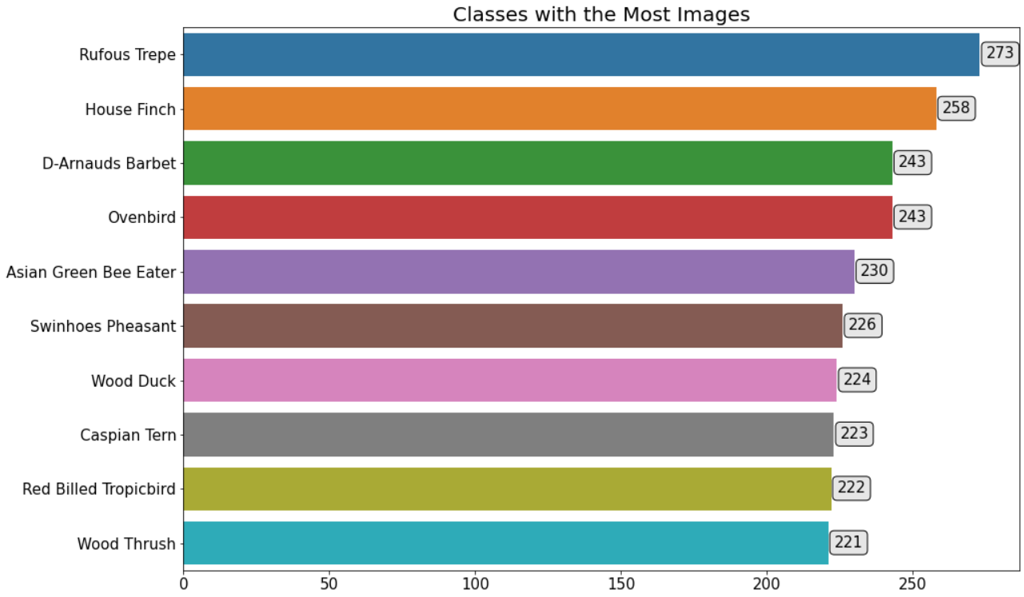
Dataset Description
The dataset consists of 400 classes containing a total of 71,407 images each with dimensions 224 x 224 x 3.
The dataset is split into a 80:10:10 ratio to generate the training, validation and testing sets as follows:
Training Set: 56,987 images
Validation Set: 7,210 images
Testing Set: 7,210 images

Slide 11
Why 80:10:10 ratio is used for datasets??
80% Training Data: Majority of the dataset is used for training the model to ensure it learns a robust representation of the data. A larger training set reduces the risk of underfitting, especially in complex models like Vision Transformers (ViTs), which require significant data to learn intricate patterns.
10% Validation Data: Used to tune hyperparameters (e.g., learning rate, batch size) and monitor the model’s performance during training. Helps prevent overfitting by evaluating the model on unseen data during training.
10% Test Data: Reserved exclusively for evaluating the final model’s performance. Provides an unbiased estimate of how the model generalizes to completely unseen data.

Slide 12
Why these 2 models (ViT_L-32) and (ViT_B-16) ?
The selection of ViT_L-32 (Large, Patch Size 32) and ViT_B-16 (Base, Patch Size 16) for bird species classification using Vision Transformers is motivated by several factors related to model capacity, task requirements, and computational trade-offs. Here's why these specific models might be chosen:
1. Range of Model Capacities
ViT_L-32 (Large, Patch Size 32):
Represents a high-capacity model suitable for capturing complex patterns and relationships in the data.
Ideal for exploring the upper limits of performance when computational resources and data availability are abundant.
ViT_B-16 (Base, Patch Size 16):
A smaller, computationally efficient model with good generalization capabilities.
A practical choice for tasks where computational resources or dataset size are limited.
2. Fine-Grained Image Classification
Bird species classification is a fine-grained task that requires attention to small details like:
Feather patterns.
Beak and eye shapes.
Subtle color variations.
ViT_B-16 is better suited for this because of its smaller patch size (16 × 16 pixels), which allows it to capture finer-grained details in the input images.

Slide 13
Why these 2 models (ViT_L-32) and (ViT_B-16) ?
3. Scalability Insights
ViT_B-16: Provides insights into how a smaller, lighter model performs on fine-grained tasks with fewer resources.
ViT_L-32: Explores how increasing model size and complexity impacts accuracy and generalization.
4. Resource and Dataset Constraints
ViT_B-16:
Suitable for scenarios with limited computational resources.
Works well for moderate dataset sizes due to its lower data requirements.
ViT_L-32:
Designed for large-scale datasets and high-performance computing environments.
Allows testing the limits of what can be achieved with additional resources.

Slide 14
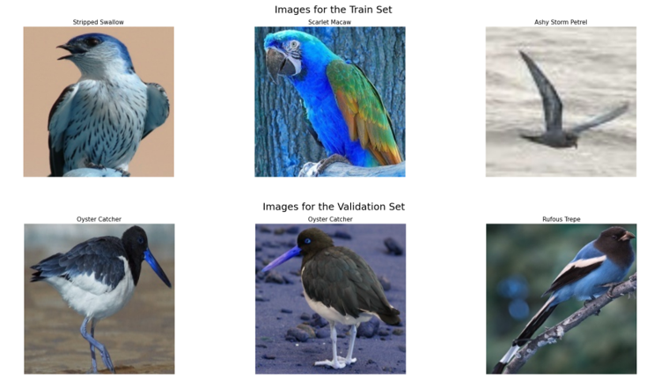
Preprocessing and Data Augmentation
Image processing operations such as rotation, width shift, height shift, shearing, zooming, and horizonal flipping are applied to the training set.
All the images in the training, validation and testing set are then normalized.

Slide 15
System Architecture

Slide 16
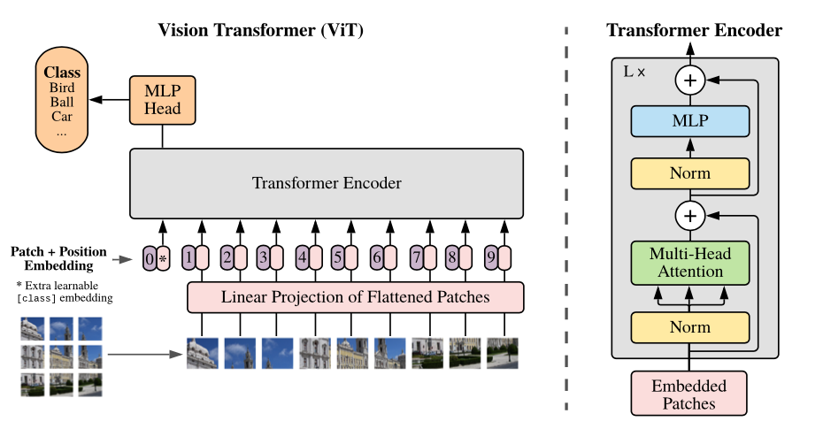
Generalized Architecture of a Vision Transformer

Slide 17
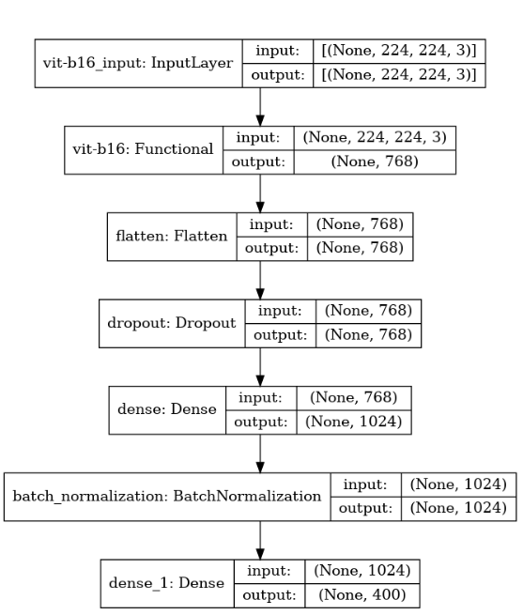
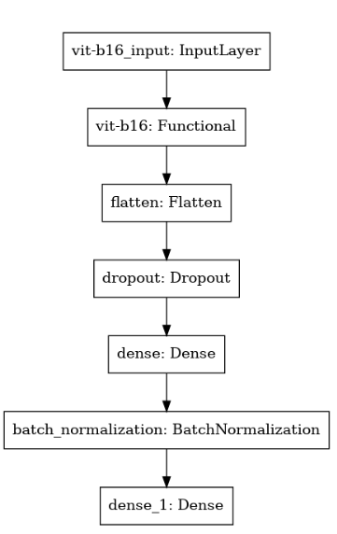
Model Architecture (ViT_B-16)

Slide 18
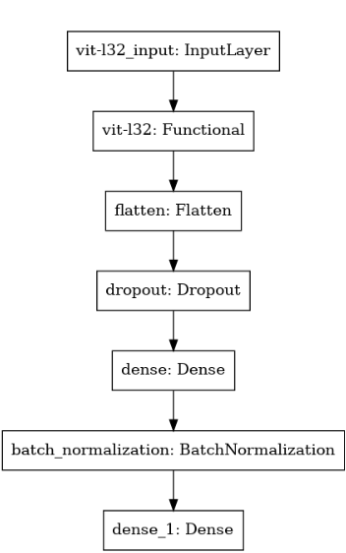
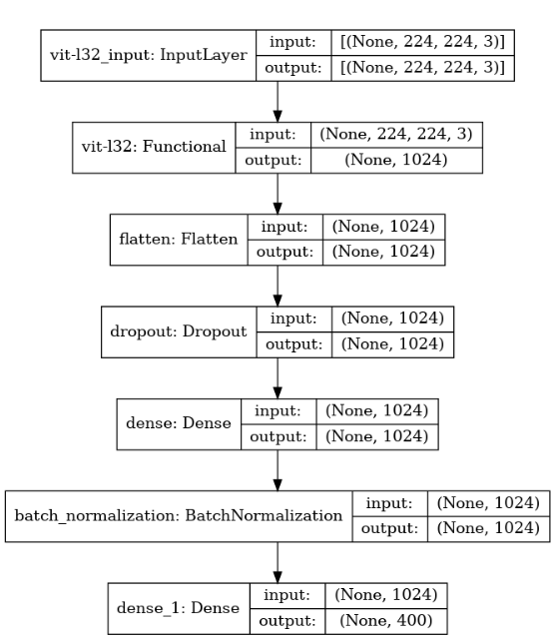
Model Architecture (ViT_L-32)

Slide 19
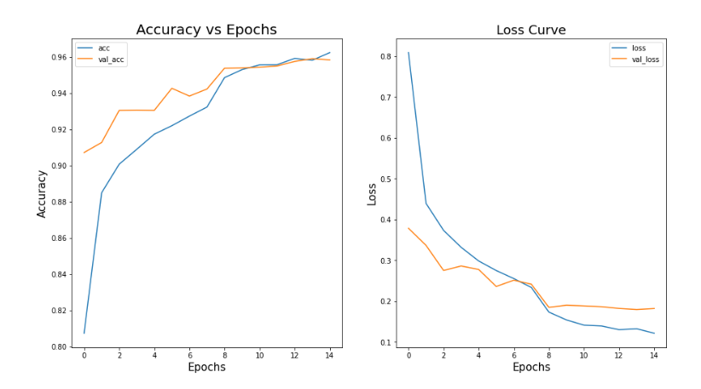
Results (ViT_B-16)

Slide 20
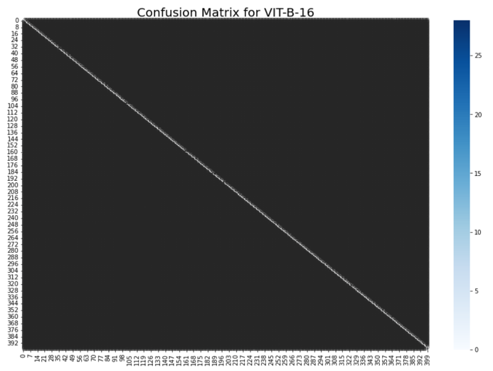
Results (Confusion Matrix for ViT_B-16)

Slide 21
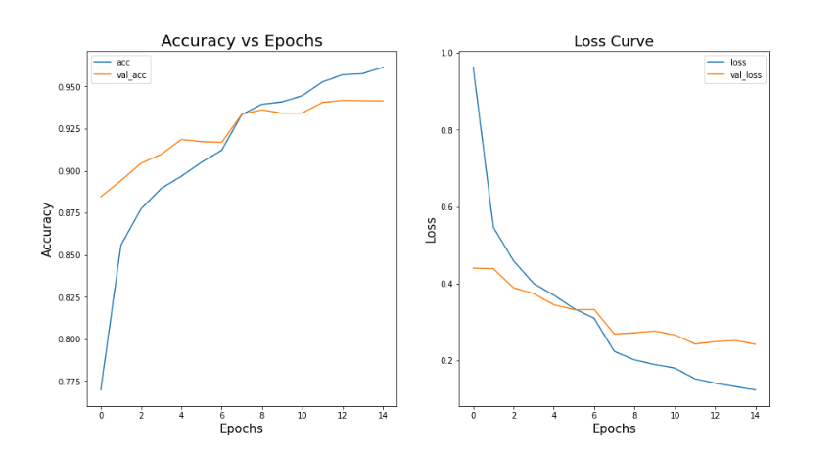
Results (ViT_L-32)

Slide 22
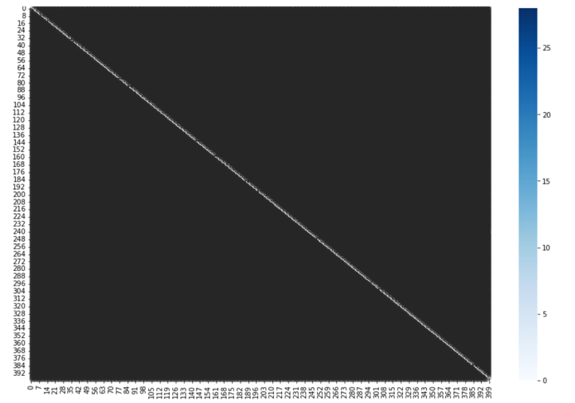
Results (Confusion Matrix for ViT_L-32)

Slide 23
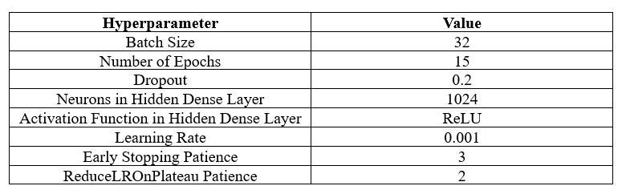
Hyperparameters Used During Training

Slide 24
Why Model Architecture (ViT_B-16) is better than Model Architecture (ViT_L-32) ?
Aspect | ViT_B-16 | ViT_L-32
Model size | Large (~307M parameters) | Base (~86M parameters)
Data requirements | High | Moderate
Computational resources | High | Moderate
Fine grained task suitability | Moderate | High
Training or inference speed | Slow | Fast
For bird species classification, where fine-grained details are crucial, ViT_B-16 is generally the preferred choice due to its smaller patch size and balanced trade-offs between accuracy and efficiency.

Slide 25
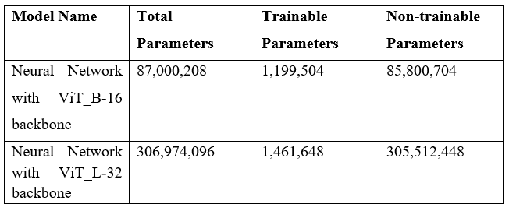
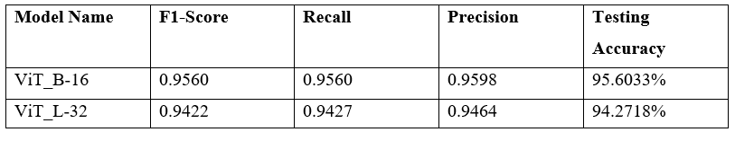
Results (Model Comparison)
Table showing number of parameters for each model
Table showing model evaluation results

Slide 26
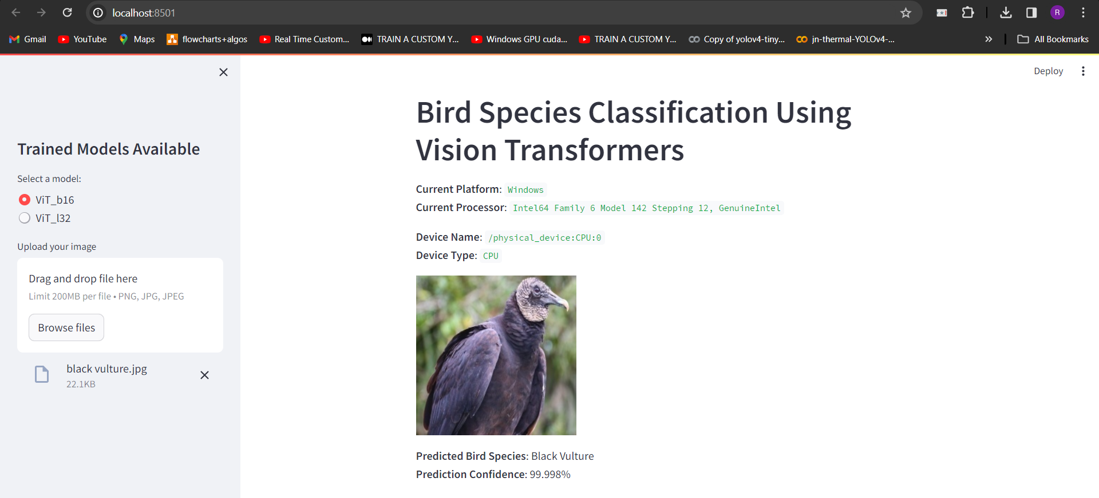
Streamlit Web Application (ViT_B-16)

Slide 27
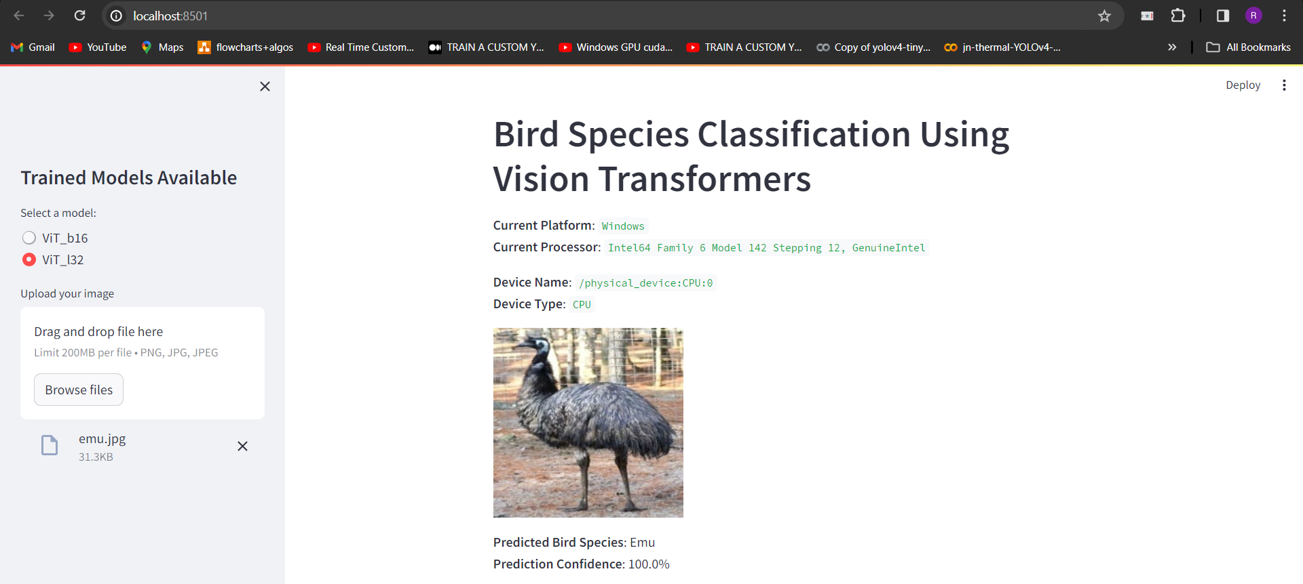
Streamlit Web Application (ViT_L-32)

Slide 28
Conclusion
Problem Identification: Recognized a gap in traditional bird species identification methods, limited by qualitative descriptions.
Objective: Develop a sophisticated and efficient bird species identification system using advancements in deep learning.
Solution: Leveraged Vision Transformers (ViT_B-16) to address the challenge.
Results: Achieved a high testing accuracy of 95.6%, demonstrating the efficacy of Vision Transformers.
Impact:
Revolutionizes ornithological research and biodiversity monitoring.
Enhances data collection and analysis efficiency.
Opens new opportunities for ecological research and conservation efforts.

Slide 29
Future Scope
Mobile Application Integration: Develop a mobile application version of the bird species identification system, allowing users to identify birds in real-time using their mobile devices.
Species Conservation Integration: Collaborate with conservation organizations to integrate the bird species identification system into conservation efforts, providing valuable data for monitoring and protection.
Community-Driven Data Collection: Encourage users to contribute to bird monitoring efforts by allowing them to submit bird sightings and related data. Implement a community-driven approach to data collection, fostering a sense of participation among users and contributing valuable information for scientific research.

Slide 30
References
[1] Noumida, A., et al. "Stacked Res2Net-CBAM with Grouped Channel Attention for Multi-Label Bird Species Classification." 2023 31st European Signal Processing Conference (EUSIPCO). IEEE, 2023.
[2] A. Marini, J. Facon and A. L. Koerich, "Bird Species Classification Based on Color Features," IEEE International Conference on Systems, Man, and Cybernetics, Manchester, UK, pp. 4336-4341, doi: 10.1109/SMC.2013.740. keywords: {Birds;Image color analysis;Image segmentation;Feature extraction;Vectors;Visualization;Histograms;pattern recognition;color features;color image segmentation;machine learning;bird species classification}
[3] Asmita Manna, Nilam Upasani, Shubham Jadhav, Ruturaj Mane, Rutuja Chaudhari and Vishal Chatre, “Bird Image Classification using Convolutional Neural Network Transfer Learning Architectures” International Journal of Advanced Computer Science and Applications(IJACSA), 14(3), 2023. http://dx.doi.org/10.14569/IJACSA.2023.0140397
[4] Shriharsha, Tushara, Vijeth, Suraj, Hemavathi, “Bird Species Classification Using Deep Learning Approach”, International Research Journal of Engineering and Technology (IRJET), Volume 07, Issue 04, April 2020.
[5] Samparthi V S Kumar, Hari Kishan Kondaveerti, "A Comparative Study on Deep Learning Techniques for Bird Species Recognition", 2023 3rd International Conference on Intelligent Communication and Computational Techniques (ICCT), pp.1-6, 2023.
[6] https://www.kaggle.com/datasets/gpiosenka/100-bird-species
[7] https://paperswithcode.com/method/vision-transformer
[8] https://github.com/faustomorales/vit-keras
[9] https://github.com/google-research/vision_transformer
[10] https://streamlit.io/

Slide 31
Thank You!!

